Slide 1
Lecture no: 4 What is Supply? (Continued chapter)
Previously, you have been introduced to the concept of demand, which was:
Consumers willingness and ability to purchase goods and services, e.g: you demanding a take-out burger, new pair of nikes.
We also learnt that when we are ONLY looking at prices, if prices go up, demand goes down and when prices go down, demand goes up. Which is also a movement along the demand curve.
However, whenever there are changes in other factors, EXCEPT price, the entire demand curve shifts, either increases or decreases.

Slide 2

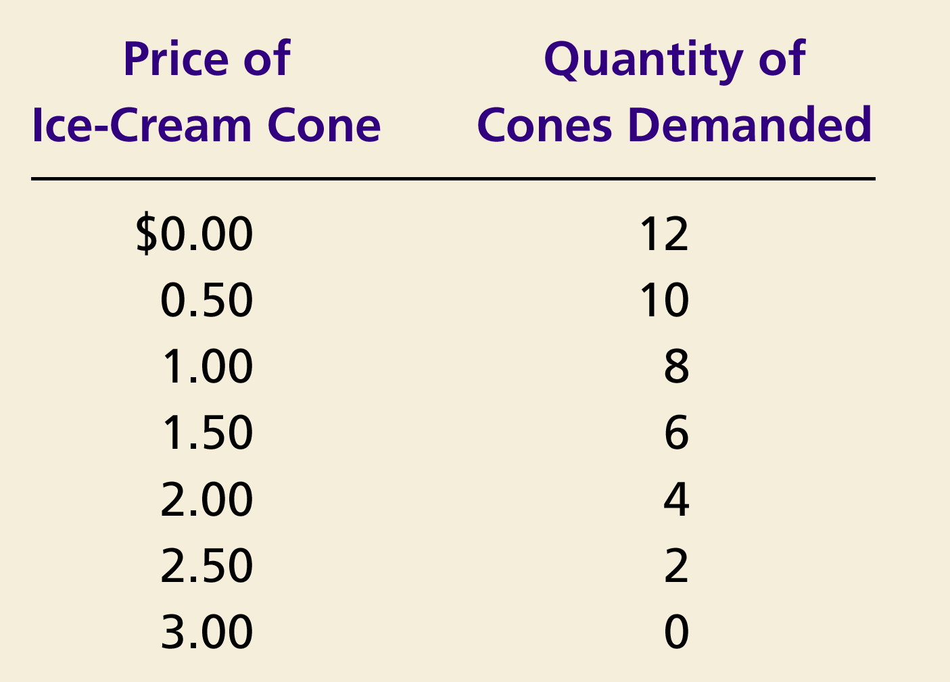
Figure 1 Catherine’s Demand Schedule and Demand Curve
Price of
Ice-Cream Cone
$3.00
2.50
1. A decrease
2.00
in price
...
1.50
1.00
0.50
0
1
2
3
4
5
6
7
8
9
10
11
12
Quantity of
Ice-Cream Cones
2.
...
increases quantity
of cones demanded.
Copyright © 2004 South-Western

Slide 3
Thinking from a supplier’s point of view concept of opportunity cost and production.
Now, you have to think from the perspective of a supplier. Meaning if you want something in the market, someone needs to supply it to you.
Previously, you were told about opportunity cost. Re-call that opportunity cost is what you give up to get something. For eg: If you spend four years in university for your bachelors, you are giving up four years of income that you could have earned. In the US, 28000 students every year do not go for university degree because they end up working for McDonald’s, KFC, or doing various odd jobs.
Suppliers also face opportunity cost. In a sense that, they need to decide what to produce, how much of it to produce and what price to charge. For eg: if a farmer grows tomato in his farm, he is giving up producing potatoes. If a car producer uses some of his factory space and workers to produce one model of a car, he cannot use the same space and workers to make another model of the car at the same time.
He needs to understand whether producing tomato is more favorable than producing potatoes, when he supplies to the market.

Slide 4
Who is a supplier?
A supplier is anyone willing and able to produce and provide goods and services to the market for consumers to purchase. The supply curve of a market represents each and every supplier’s production of the particular good.
Suppliers charge a price for their product. In competitive markets, you will see that all suppliers charge similar prices.
For example: you decided to buy the Mankiw (this is the book, you need for this course incase you didn’t know) book from Nilkhet. you see hundreds of shops and enters the first shop, the seller says....

Slide 5
Who is a supplier?
What did you understand from here…
There is a minimum price, meaning after a certain point, no matter how much you bargain, the supplier does not lower his price. But why?
Every supplier has a cost attached with its product. He has to recover that cost, hence will charge a minimum price for that product.

Slide 6
The Law of Supply
Recalling, law of demand: Other things equal, the higher the price of a product, the lower the quantity demanded. The lower the price of a product, the higher the quantity demanded.
For Supply:
Other things remaining the same, the higher the price of a good, the greater is the quantity supplied; and the lower the price of a good, the smaller is the quantity supplied.
Supply is a function of own price, input prices, and technology

Slide 7
The Supply Schedule
Supply schedule: A table that shows the relationship between the price of a good and the quantity supplied.
Example:
Cinnamon’s supply of ice-cream
Price of ice-cream | Quantity of ice-cream supplied
BDT 0.00 | 0
1.00 | 10
2.00 | 30
3.00 | 40
4.00 | 50
5.00 | 60
Notice that Cinnamon’s supply schedule obeys the Law of Supply.

Slide 8
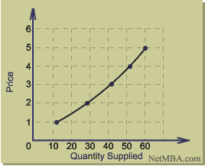
Price of ice-cream(BDT) | Quantity of ice-cream supplied
0.00 | 0
1.00 | 10
2.00 | 30
3.00 | 40
4.00 | 50
5.00 | 60
What do you notice about the curve?
It is upward sloping, so gradient is positive or negative?
Price and quantity supplied have a positive relationship
Recalling the demand curve. What is different?

Slide 9
Figure 1 Catherine’s Demand Schedule and Demand Curve
Price of
Ice-Cream Cone
$3.00
2.50
1. A decrease
2.00
in price
...
1.50
1.00
0.50
0
1
2
3
4
5
6
7
8
9
10
11
12
Quantity of
Ice-Cream Cones
2.
...
increases quantity
of cones demanded.
Copyright © 2004 South-Western

Slide 10
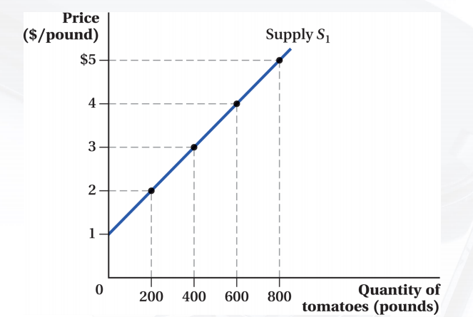
At the price of $2 per pound or less, suppliers find it unprofitable to sell any oranges so they are unwilling to supply any. However, beyond $1 they are willing to sell.
As the price increases beyond $2, suppliers will provide more and more oranges to the market. Hence, indicating a positive relationship.

Slide 11
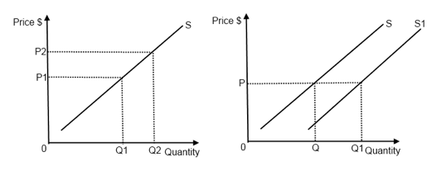
Supply curve can change in two ways: Movement along the supply curve Shift in the supply curve
.
A shift is caused by factors, OTHER than price. It is when at current prices, producers/suppliers supply more.
Change in quantity supplied: A movement along the supply curve that occurs as a result of a change in the good’s price.

Slide 12
Factors that shift the supply curve.
Recall, there are two ways supply can change: 1) When the price of the good supplied changes, there is a movement along the supply curve. 2) When any factor that influences selling plans, except prices, there is a shift in supply. Five main factors bring a shift in supply. They are:
The prices of factors of production
Prices of other goods
Expected future prices
The number of suppliers
Technology
Natural Conditions
Taxes and subsidies

Slide 13
The prices of factors of production
Factors of production: Land, labour, capital and entrepreneur. You need these to produce goods and services. Hence, they are called factors. These can also be referred to as ‘changes in the costs of production’
Higher costs: Suppose you are making a car, an important ingredient in manufacturing cars is steel. Suppose the price of steel increases, producing the same car becomes expensive as cost of production rises. As a result of the higher manufacturing costs, the supply curve shifts to the left, Firms will profit less per car, so they are motivated to make fewer cars at a given price, decreasing the quantity supplied.
Lower costs: Why is Bangladesh consistently ranked highest for our garments industry? Due to cheap and available labor. Labor is an essential factor of production. Because the cost of labour which is a factor of production is low, the supplier is able to produce more at the current prices.

Slide 14
Prices of other goods
The supply for one good is based on the prices of other goods that use the same resources for production. A change in the price of a substitute good (or substitute-in-production) encourages sellers to alter the mix of goods produced, that is, to produce more of one good and less of another. An increase in the price of a substitute motivates sellers to sell less of this good as more of the substitute good is produced. A change in the price of a complement good encourages sellers to supply more or less of both goods, jointly. An increase in the price of a complement motivates sellers to sell more of this good as they sell more of the complement good, too.
Examples: next slide

Slide 15
Prices of other goods
Substitute: An example is using farmland and other resources to produce one of two crops, either corn or soybeans. The farmer can switch to producing corn from soybeans
Substitute in production: suppose instead of using steel, you use aluminum. If the price of aluminum goes up, suppliers would switch to producing aluminum and reduce supply of steel at current prices.
Complement: Cars and Steels. If there is an increase in the prices of car, suppliers of steel will also increase their supply

Slide 16
Expected future prices
Suppliers may change their supply depending on their expectation of future prices.
If the price of a good is expected to rise, the return from selling the good in the future is higher than it is today. So supply decreases today and increases in the future. If price of a good is expected to fall in the future, suppliers may want to sell more at current prices.
Example: next slide.

Slide 17
Expected future prices
Expectation of future prices to increase: On a normal day, the price of hilsha fish (ilish mach) is around 200tk/kg. But you will notice that during the coming days of Pohela Baishakh, the prices of hilsha fish go up. This is because suppliers anticipated that during this time, they can charge a higher price. So they will buy and keep some in stock to supply during this time.
Chick peas after ramadan. Suppliers anticipate that after ramadan, the price of chick peas would fall, so they increase their quantity now (release any stock being held in the market) at current prices.
Suppose, real estates expect that prices of houses would fall in the future. They would want to supply more of it now at current prices as in the future, their revenue would fall.

Slide 18
The number of suppliers
The number of suppliers: the greater the number of suppliers, the more the competition.
The larger the number of firms that produce a good, the greater is the supply of the good. And as firms enter an industry, the supply in that industry increases. As firms leave an industry, the supply in that industry decreases.
For example: If more companies start to make motorcycles, the supply of motorcycles would increase. If a motorcycle company goes out of business, the supply of motorcycles would decline, shifting the supply curve to the left.

Slide 19
Technology
The term “technology” is used broadly to mean the way that factors of production are used to produce a good. Technology changes both positively and negatively. A positive technology change occurs when a new method is discovered that lowers the cost of producing a good. A positive technology change increases supply, and a negative technology change decreases supply.
If a new method or technique of production is developed, the cost of producing each good declines and producers are willing to supply more at each price - shifting the supply curve to the right. For example: robots in the production of cars. They are quicker, less errors and efficient, so cost of production goes down. At current prices, supplier are able to supply more.
Similarly, by bringing in robots, you are also reducing supply of manual labour, which means at current prices of labour, quantity supplied is falling.

Slide 20
Natural Conditions
Agricultural goods are significantly affected by natural conditions, such as drought, flood, pesticide attacks.
Goods such, sugarcane for sugar, potatoes, tomatoes, rice. If a natural condition affects their production, the supply curve would shift. Meaning, at current prices, suppliers will either be supplying less or more to the market.
E.g: Suppose, cocoa beans (these are used to make chocolate), and they are at times affected by pesticide. During this time, the prices of cocoa beans would remain the same but less quantity is supplied.

Slide 21
Taxes and subsidies
The government plays a vital role in determining the quantity supplied in the market. Higher taxation increases the price of a commodity in the market, resulting in consumers buying less, in turn lowering the supply. Government subsidies reduce the cost of production, thus firms are able to make more commodities for the market. The supply curve shifts to the right, depending on the value of the subsidy.
Tax cuts: Government encouraged firms to set up in Chittagong by reducing intial tax payments as an incentive to increase economic activity in chittagong
Subsidy: Government can provide subsidy to farmers by providing them with reduced land costs. In Ghana, government encouraged farming of ginger by giving reduced land rates to women to encourage women to farm.

